Slide 1
University of Basrah/collage of veterinary Medicine department of Veterinary surgery and obstitric
Affections of the salivary gland and tongue
Dr. Alaa Ahmed Ibrahim

Slide 2
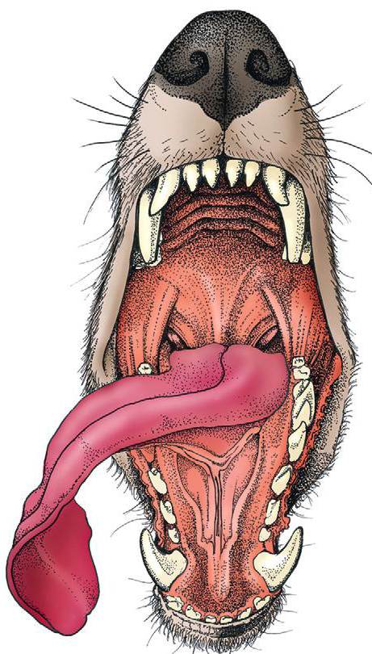
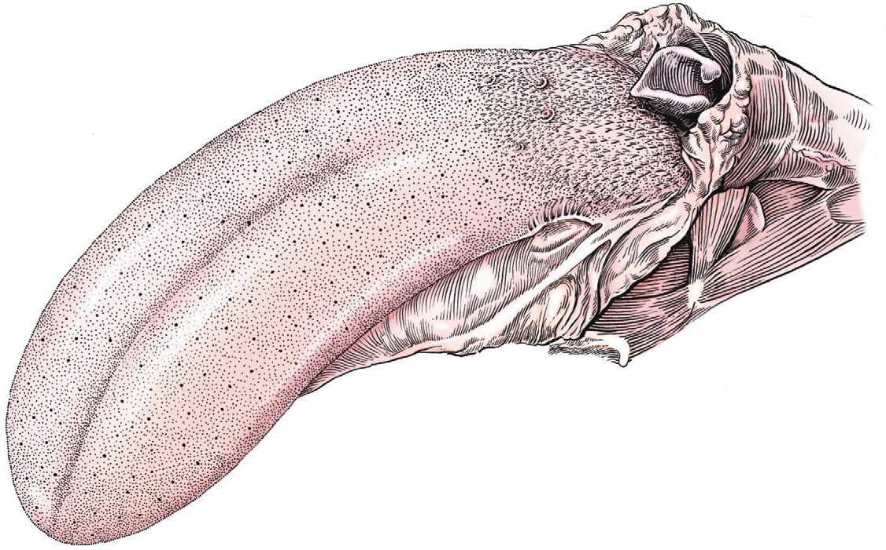
Tongue anatomy
Tongue consist of root attached oropharynx
Body attached to floor of oral cavity by frenulum
Apex

Slide 3
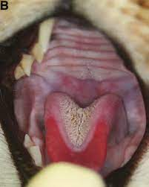
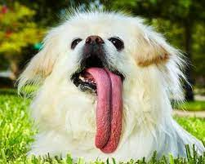
Congenital disorders of the tongue
Tongue malformation such as macroglossia , microglossia , and tognue deviation are rare in dogs and cats

Slide 4
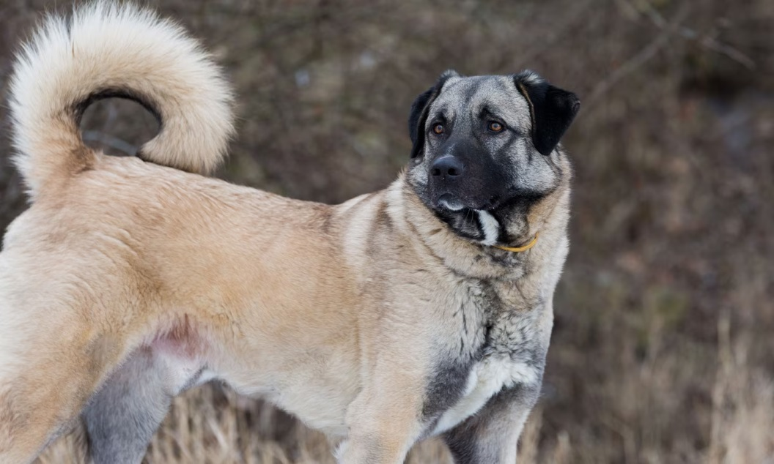
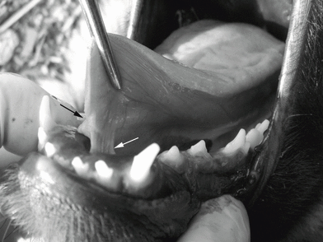
Ankyloglossia (tongue tie)
lingual frenulum is thickened and short and this will restrict the tongue movement
Difficulty in sucking , licking , swallowing , and vocalization result in stunted growth , ptyalism, and difficulty eating.
Described in Anatolian shepherd dogs

Slide 5
Tongue Infectious disorders
Tongue is rare site of infection (highly vascularized ,tough dorsal surface,ability to avoid penetrating injury , continual contact with saliva)
Common site of penetrating inj. Of oral cavity is underneath tongue
Penetrating inj. Can cause lingual abscess
Large abscess may produce ventral cervical swelling ,pain upon mouth opening , dysphagia
Treatment involve active or passive drainage
Marsupialization of the abscess into the oral cavity after surgical drainage may help prevent reformation of the abscess and provides a route for drainage.
Penrose drain for large lingual abscess is warrented

Slide 6
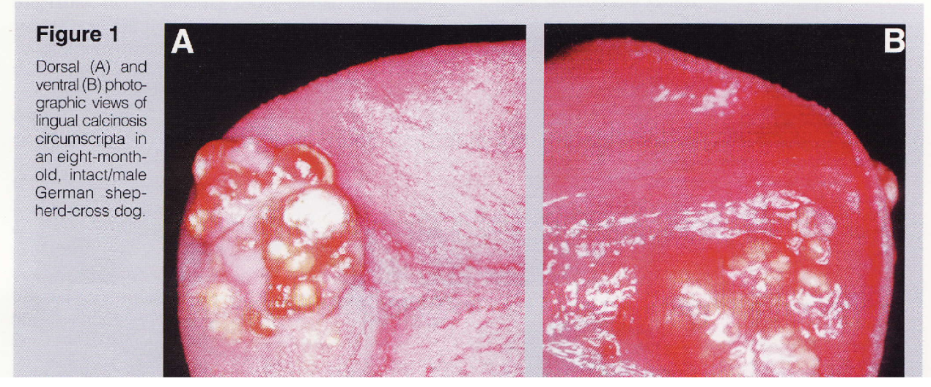
Calcinosis circumscripta(Ectopic mineralization )
Uncommon rarely described in cats, dogs. And domestic and wild animals
Etiology : tissue injury (dystrophy ), abnormal calcium or phosphor metabolism secondary to renal failure(metastatic), unknown etiology (idiopathic)
Surgical excision may be performed; however, treatment is usually not necessary
unless dysphagia
is present..

Slide 7
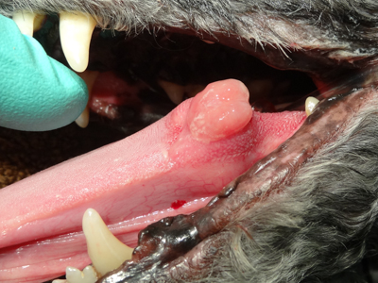
Tumors of the tongue
Represent 3%-4% of all oropharyngeal tumors
common lingual tumors are Malignant melanoma ,squamous cell carcinoma followed by squamous papilloma, plasmacytoma, and fibrosarcoma.
Oral papillomatosis usually affect dogs younger than 1 year of age and has a viral cause. White, translucent nodules on the tongue and gingiva may be quite numerous. Lesions regress without any specific treatment within 4 to 8 weeks.

Slide 8
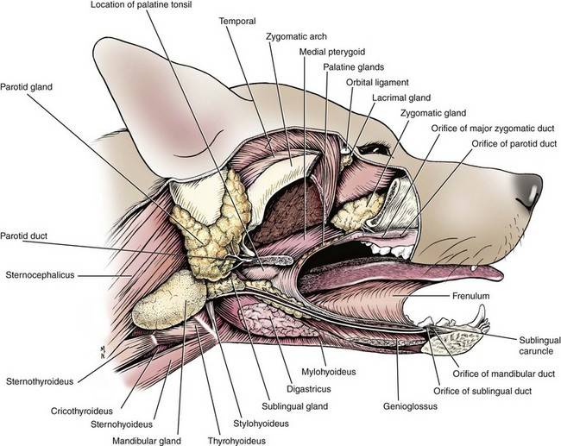
Salivary glands
The four major salivary glands in dogs and cats are the parotid, mandibular, sublingual, and zygomatic
The minor salivary glands are named by their location and drain directly into the oral cavity

Slide 9
Affections of the salivary glands :
Non-surgical salivary gland diseases include
Sialadenosis :noninflammatory swelling of the salivay gland (most commonly mandibular gland ). The cause is unknown . Clinical signs include swelling of the affected gland which is not painful , hypersalivation, wretching, gulping, and lip smacking
Treatment with 1 to 2 mg/kg of phenobarbital twice a day, however, may improve clinical signs within 1 to 2 days. Recurrence of clinical signs after cessation of medical management is possible; therefore, lifelong phenobarbital therapy may be required .

Slide 10
Sialadenitis and Necrotizing Sialometaplasia
Sialadenitis is inflammation of the salivary gland which occasionally progress to glandular necrosis and ductal metaplasia
Clinical signs very similar to Sialadenitis excepet pain and vomiting .
Response to phenobarbital has also been reported

Slide 11
Surgical salivary gland diseases
Sialocele (salivary mucocele ): Is collection of the saliva within subcutaneous tissue. Resultant saliva –filled cavity lined by inflammatory connective tissue and are not true cyst.
Most common source of saliva is leakage from sublingual salivary gland but origination from any gland is possible.
Causes : trauma , Sialoliths, , neoplasia , foreign bodies , unknown causes (majority )
The location of the sialocele indicates the affected salivary gland. The four main presentations are exophthalmos (zygomatic sialocele) labored breathing (pharyngeal sialocele); dysphagia (sublingual sialocele or ranula); and, most commonly, intermandibular or cranioventral cervical swelling (cervical sialocele).

Slide 12
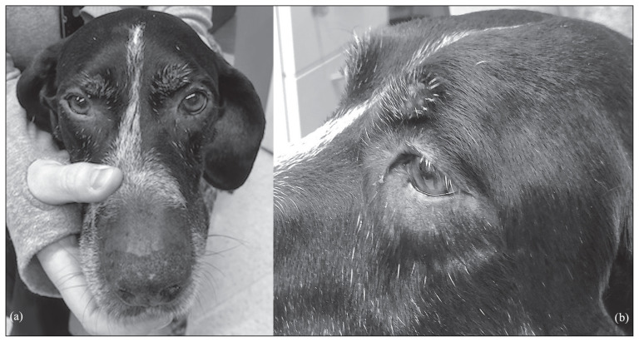
Zygomatic Sialoceles
Usually result in exophthalmos , protrusion of the third eyelids or painless orbital swelling.Examination of the oral cavity reveals deviation of the oral mucosa in the upper last molar region .
Diagnosis : aspiration of saliva , sialography, biopsy , cross-sectional image .Treatment : zygomatic sialadenectomy

Slide 13
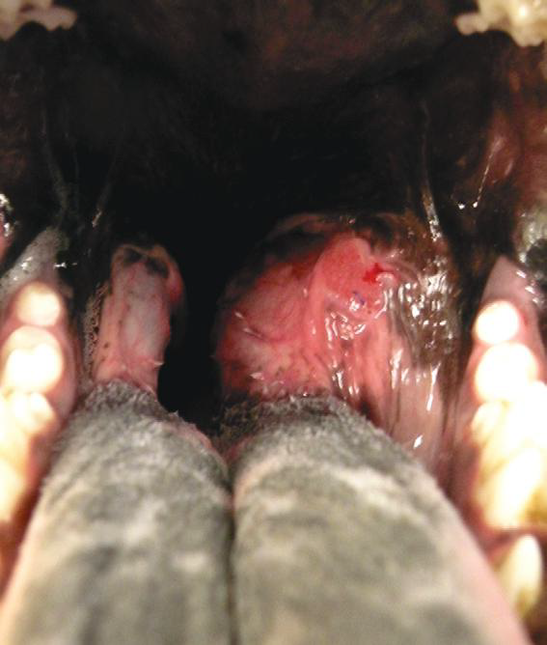
Pharyngeal sialoceles
Uncommon , and are swelling formed in the caudal dorsal or lateral pharynx just rostral to the level of epiglottis .
Primary clinical sign is labored breathing and pose a risk of airway obstruction .Affected animals presenting with respiratory distress require immediate drainage , aspiration , or placement of temporary tracheostomy tube .

Slide 14
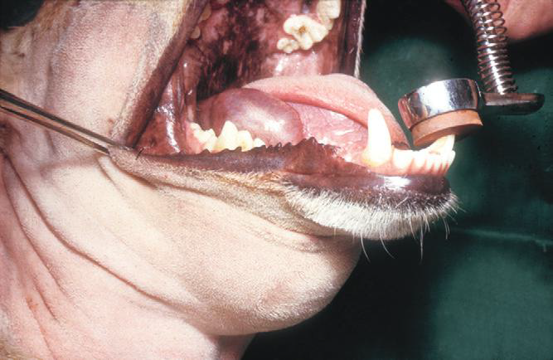
Sublingual sialoceles (ranulas):
Usually result from leakage of the rostral sublingual salivary glands or ducts.This type of sialocele cause tongue deviation resulting in in prehending , chewing , or sometimes swallowing of food .
Complete removal of mandibular and sublingual salivary gland and duct complex through ventral aspect should stop saliva supply to ranula .

Slide 15
Cervical sialoceles :
Most common sign is an acute onset of swelling in the intermandibular or ventral cervical region which is not painful , fluctuant , and changes in size.
Diagnosis by aspiration of thick ,viscous , and honey-like fluid from the swelling .
Treatment :drainage alone a is not recommended because of high rate of recurrence and the prognosis is excellent when sialadenectomy is performed .
Postoperative complications :seroma. Infection, recurrence , sublingual swelling , bleeding

Slide 16
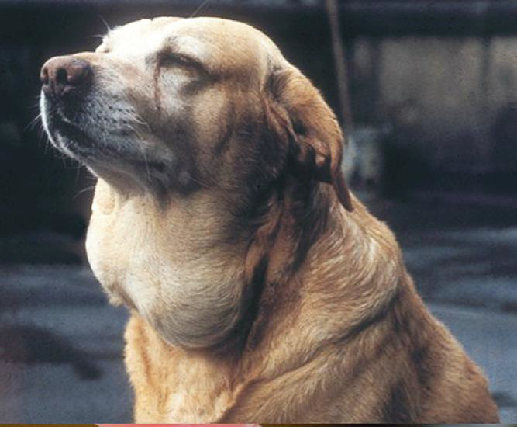

Slide 17
sialoliths
Rare in dogs and cats and most common associated with parotid duct but also reported in mandibular-sublingual duct complex.
composition may include calcium ,oxalate ,phosphate ,magnesium ,carbonate, ammonium , or non -mineralized proteinaceous materials
Non-mineralized proteinaceous materials are not true Sialoliths ,they are thought to be mineralized folds of sialocele lining that have slough into duct lumen
Clinical signs:swelling on the lateral aspect of the face that may be painful and may regress and reoccur

Slide 18
Sialolirhs treatment strategies
Duct and gland removal
Duct ligation
Duct resection and anastomosis
Marsupialization of the dilated duct into the oral cavity.
Incision over the stone for removal with primary duct repair or not repair .

Slide 19
Salivary gland neoplasia:
Primary salivary gland neoplasia of major and minor glands is uncommon in dog and cat . Most common type are adenocarcinoma and acinic carcinoma and most common affected glands are mandibular and parotid salivary glands .
Clinical signs :Variety of clinical signs, including a unilateral, nonpainful, firm swelling in the region of the upper neck, base of the ear, and upper muzzle or maxilla; halitosis(رائحة فم كريهة ); exophthalmos; and dysphagia
Diagnosis : Biopsy( by needle or incisional) from mass and surrounding lymph nodes and three -view thoracic radiograph for metastasis .Blood work and abdominal ultrasonography ,CT, and MRI.

